Slide 1
What Works to Prevent Violence against Women and Girls: Impact at Scale

Slide 2
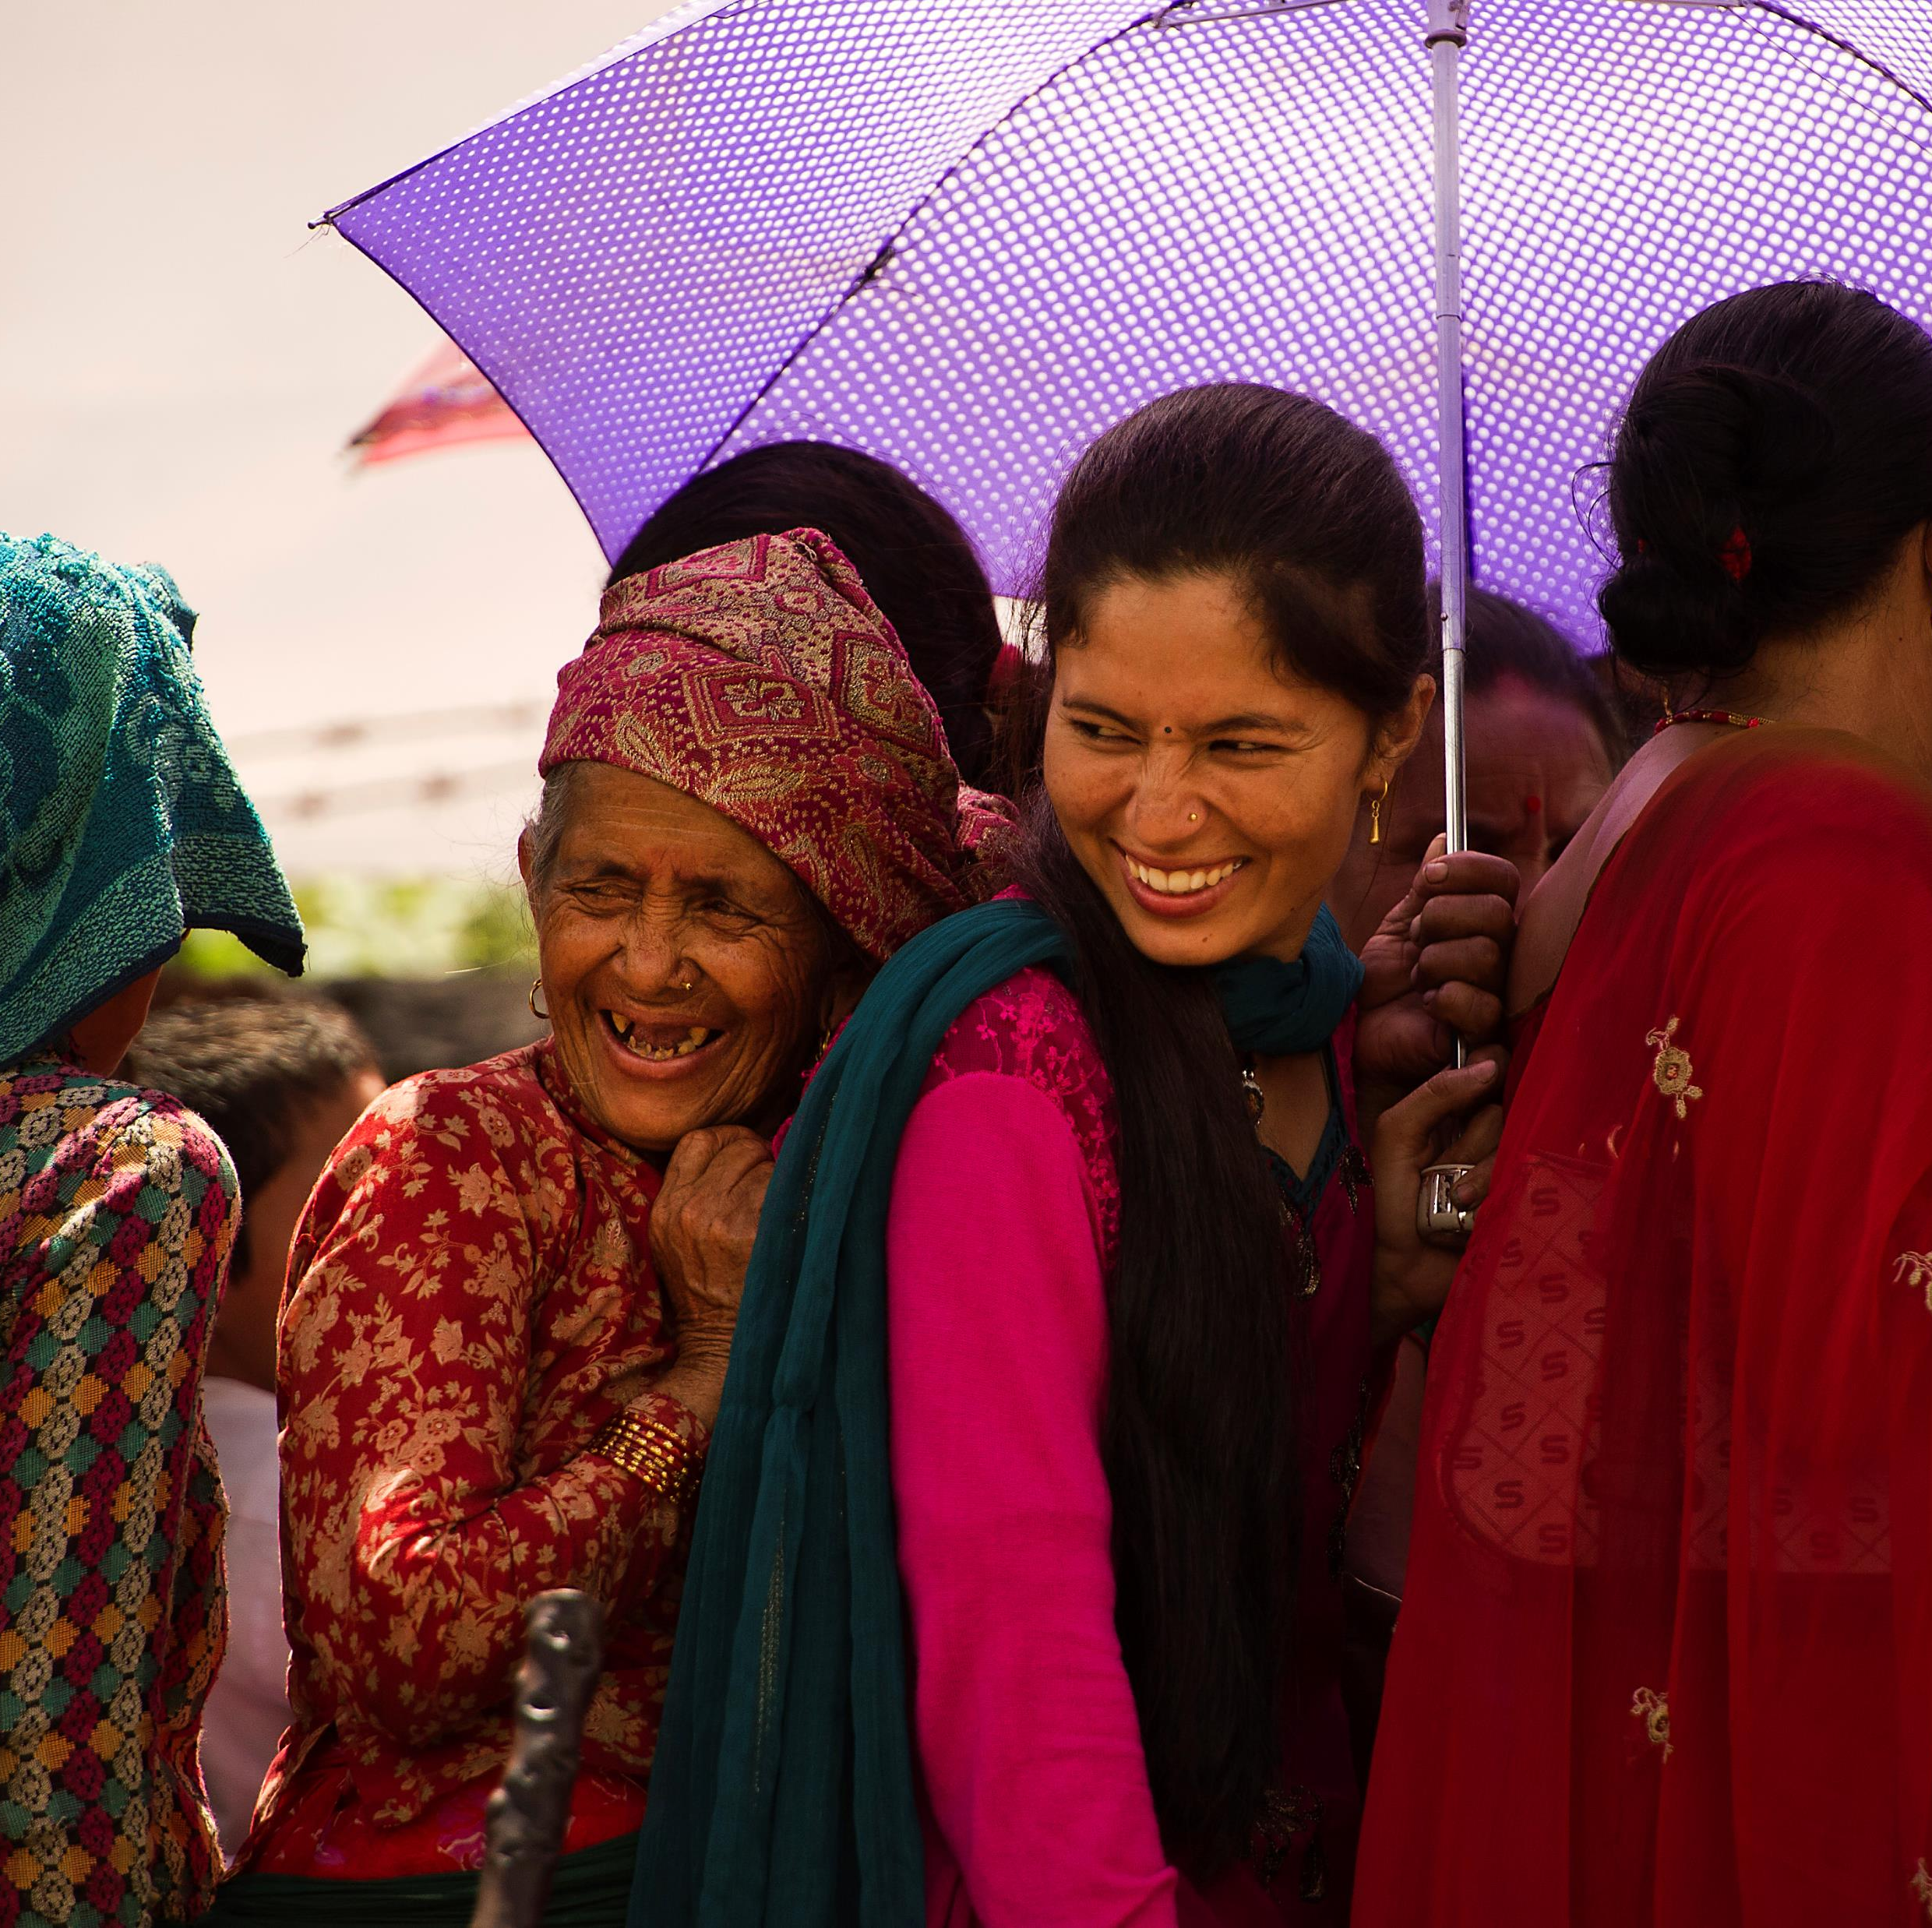
Building the prevention field
State of play
Prevention is possible
Evidence leading investment

Slide 3
‘What Works: Impact at Scale’
A global seven-year investment
Consortium membership
Learning about scale
Grant-making
VAWC Helpdesk

Slide 4
Advancing knowledge on prevention
Learning from What Works 1 and the wider field
Valuing practice-based knowledge

Slide 5
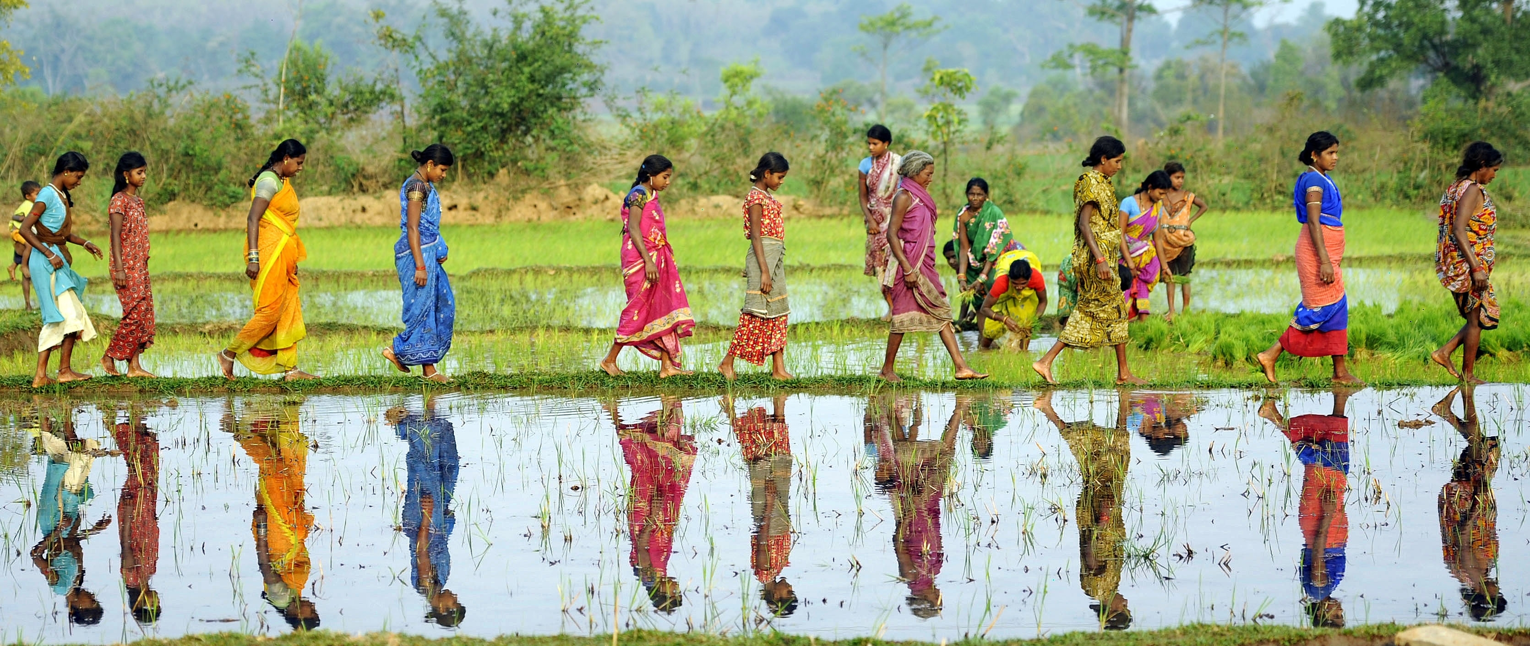
Setting out our vision
Commitment to feminist principles

Slide 6
Testing new frontiers in prevention
Learning about scale
Forms of violence
Innovation

Slide 7
Grants for VAWG Prevention
22 grants:
3 scale up
15 innovation
4 Mainstream
2 windows – Late 2022 and late 2025
Regions: Asia, Middle East and North Africa, Sub-Saharan Africa

Slide 8
Building solidarity in the VAWG field

Slide 9
We want to hear from you …
Listening exercises over December and January online and in person
Reach out on Twitter …
WhatWorks2PreventVAWG
@WW2PreventVAWG

Slide 10
Thank you
WhatWorks2PreventVAWG
@WW2PreventVAWG

